Slide 1
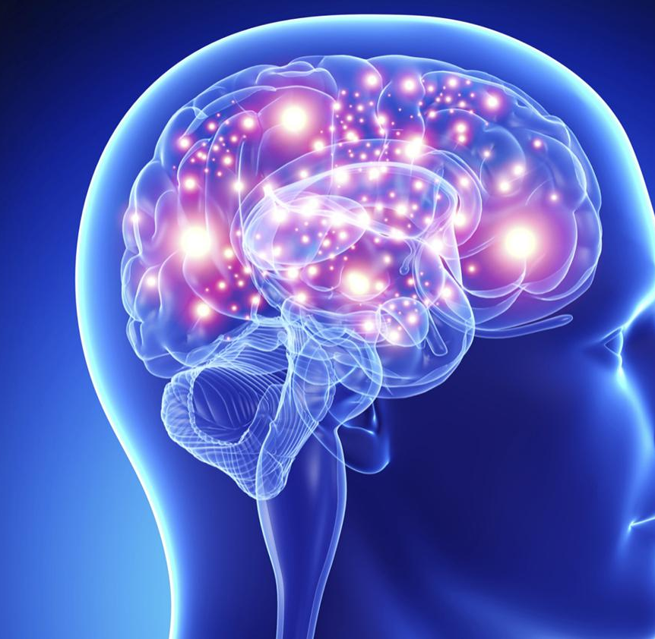
Acute Stroke & Management
Dr Mark McGlinchey
Consultant Physiotherapist
Guy’s and St Thomas’ NHS Foundation Trust
18th March 2025

Slide 2
By the end of this lecture, students should be able to
explain the contemporary management of stroke in the acute phase
discuss the role of the physiotherapist in the early management of stroke

Slide 3
Stroke
“a neurological deficit attributed to an acute focal injury of the central nervous system by a vascular cause”
second most common cause of death and disability globally
stroke is a hyperacute emergency

Slide 4
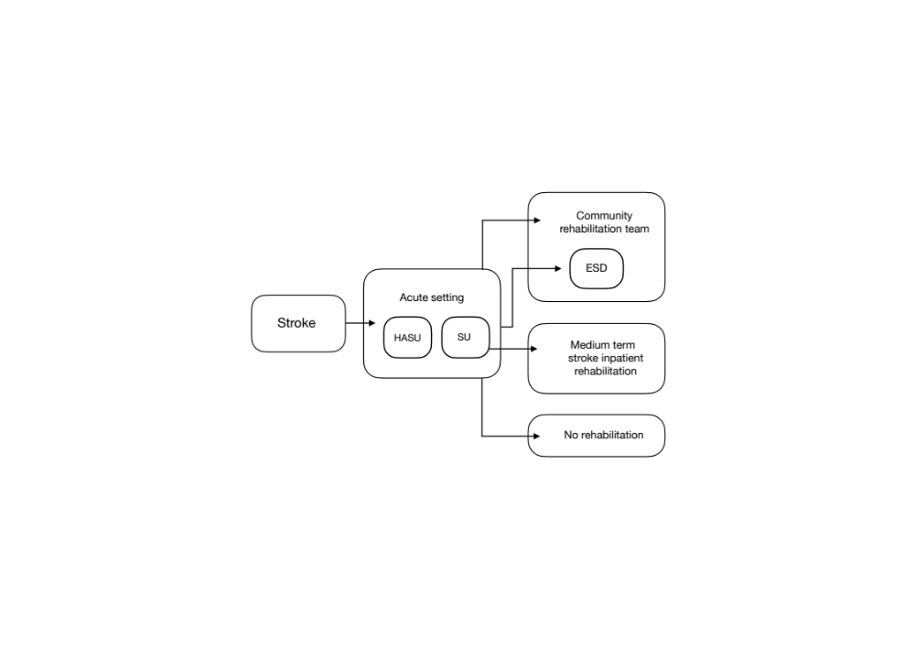
London Stroke Pathway

Slide 5
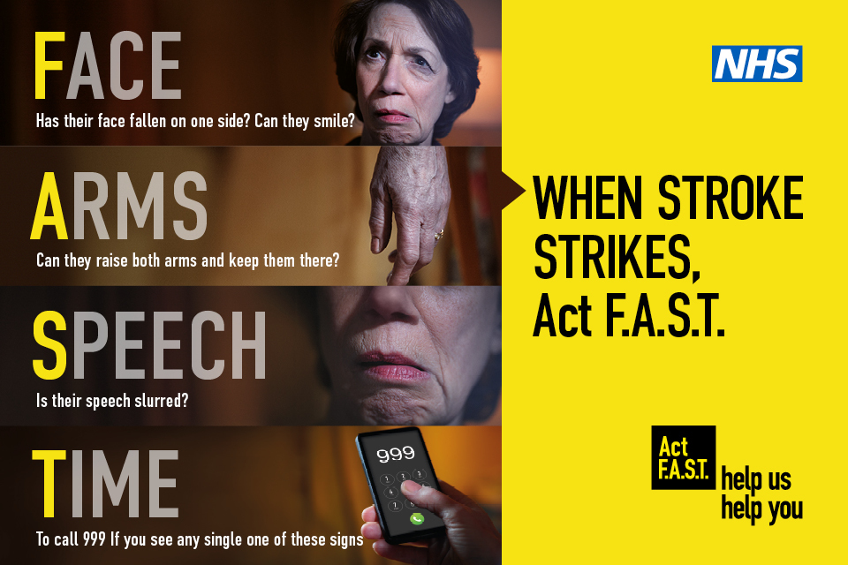
Notes:
transferred to specialist acute stroke unit within 1 hour
brain imaging within 1 hour of hospital arrival

Slide 6
Principles of Acute Stroke Management
Diagnose stroke type
Maintain physiological homeostasis
Prevent complications
Commence early rehabilitation

Slide 7
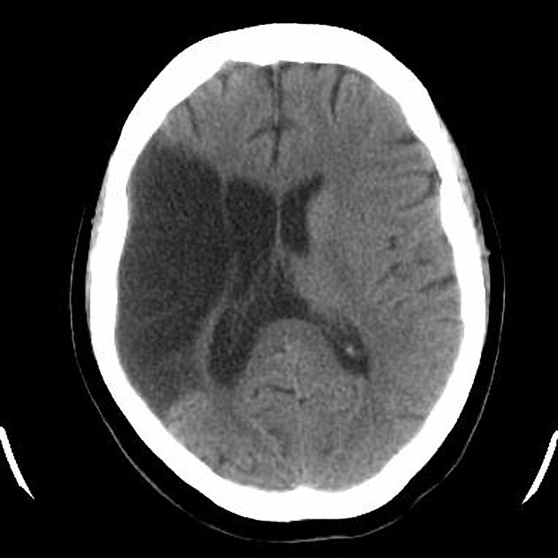
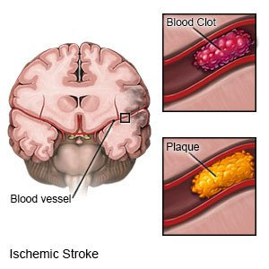
Ischaemic Stroke
Notes:
ischaemic stroke is the most common type of stroke (87.5%)

Slide 8
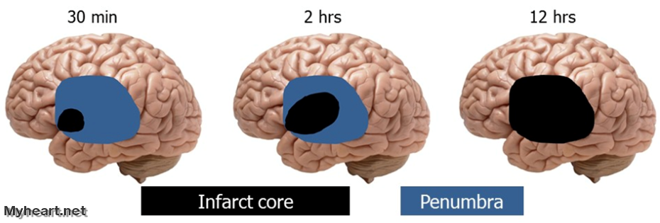
Ischaemic Stroke

Slide 9
Management of Ischaemic Stroke
preservation of penumbral tissue surrounding ischaemic core
thrombolysis within 4.5 hours of symptom onset (alteplase or tenecteplase)
mechanical thrombectomy within 6 hours of symptom onset for large artery occlusion within anterior circulation
decompressive hemicraniectomy for large MCA territory strokes with specific criteria

Slide 10
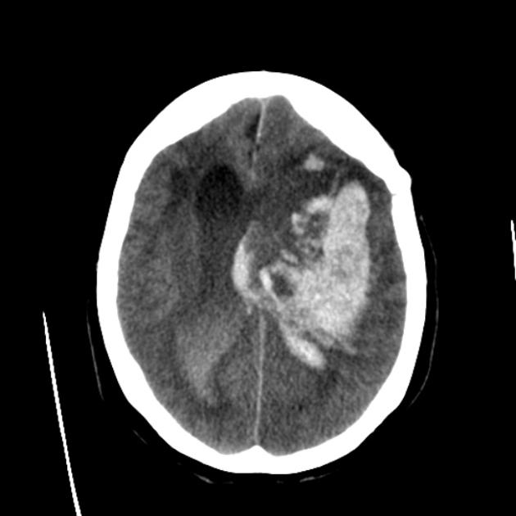
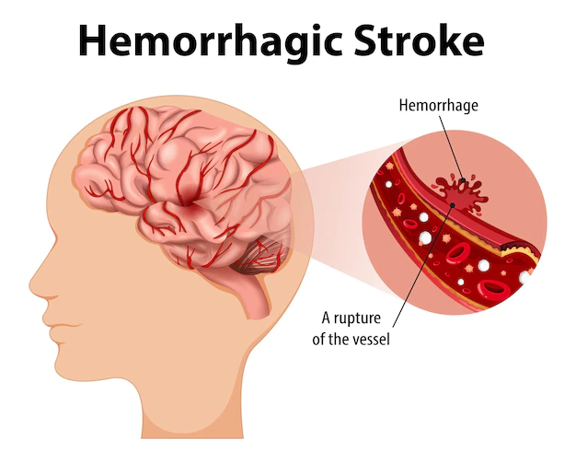
Haemorrhagic Stroke
Notes:
haemorrhagic stroke comprises ~ 12.5% of cases

Slide 11
Management of Haemorrhagic Stroke
reversal of anticoagulation agents
blood pressure management- aiming for systolic BP between 130-139 mmHg for the first 7 days
neurosurgery in some instances e.g. external ventricular drain to manage hydrocephalus, clipping of burst aneurysm

Slide 12
Maintain Physiological Homeostasis
patients should have their clinical status monitored closely, including:
level of consciousness
blood glucose (5 – 15 mmol/L)
blood pressure
oxygen saturation (O2 only if saturation <95%)
hydration and nutrition, including safe swallowing
temperature
cardiac rhythm and rate

Slide 13
Post-Stroke Complications
post-stroke are common, with a frequency between 30 – 95%
post-stroke complications are associated with poor outcome, including death and disability
factors associated with post-stroke complications include stroke severity, older age, pre-existing disability, diabetes mellitus, and length of hospital stay beyond 30 days
many post-stroke complications are potentially preventable and treatable

Slide 14
Post-Stroke Complications
Body System | Complication
Neurological | recurrent stroke, haemorrhagic transformation, epileptic seizures
Cardiovascular | cardiac arrythmias, deep vein thrombosis, pulmonary embolism
Respiratory | chest infection
Skin | pressure sores
Musculoskeletal | contractures, hemiplegic shoulder pain, falls
Gastrointestinal | dysphagia, malnutrition
Genitourinary | urinary tract infection, urinary and faecal incontinence
Cognitive | pain, fatigue

Slide 15
Prevention of Common Complications
Complication | Prevention and Management Strategies
Recurrent stroke | antiplatelet or anticoagulant medication
Deep vein thrombosis | intermittent pneumatic compression
Pressure sores | positioning, pressure relieving mattresses, adequate nutrition
Contractures | regular assessment, positioning, passive ranging
Pain | specialist assessment, strategies based on assessment findings
Chest infection | swallowing/respiratory assessment, strategies based on assessment
Urinary tract infection | regular personal care, adequate hydration, avoid catheter use

Slide 16
Physiotherapy Early
Post-Stroke
Interventions for respiratory problems
Positioning
Early mobilisation
Upper limb management

Slide 17

Respiratory Management
Respiratory problems post stroke can be divided into:
neurological e.g. apnoea
infective e.g. aspiration pneumonia
cardiovascular e.g. pulmonary embolus
Physiotherapy management involves:
positioning
sputum clearance techniques
Treatment of atelectasis
Mobilisation
patient/staff education

Slide 18
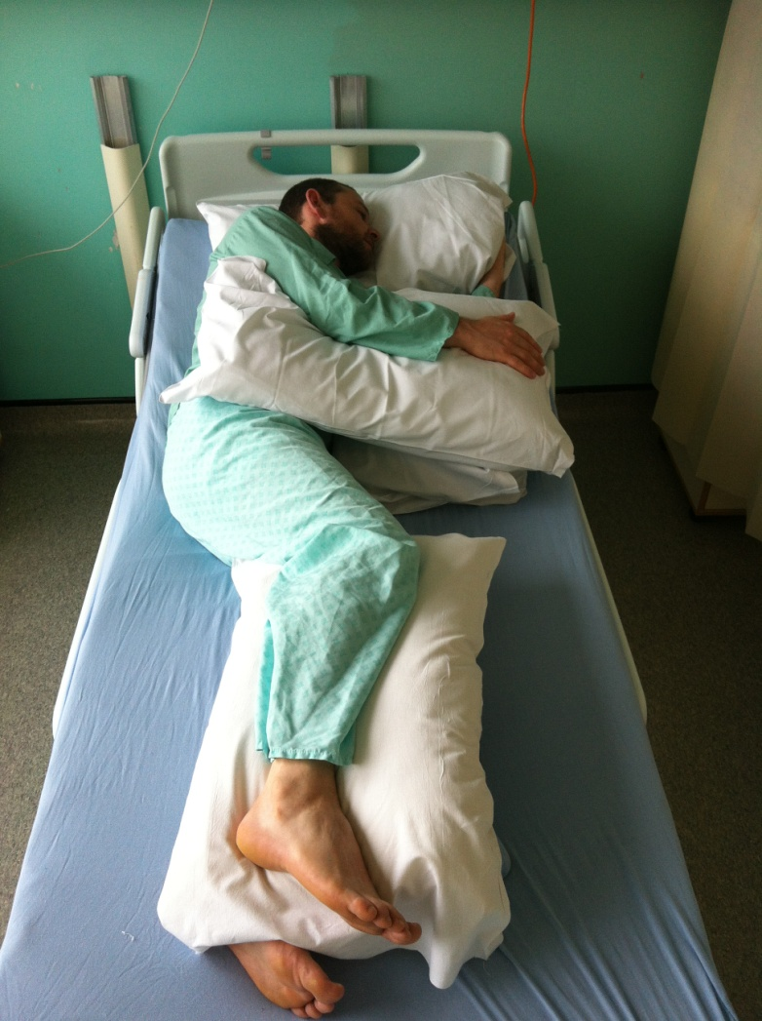
Positioning
correct positioning is postulated to:
promote functional recovery
prevent complications
improve physiological functioning
patients should have an initial specialist assessment for positioning as soon as possible and within 4 hours of arrival at hospital

Slide 19
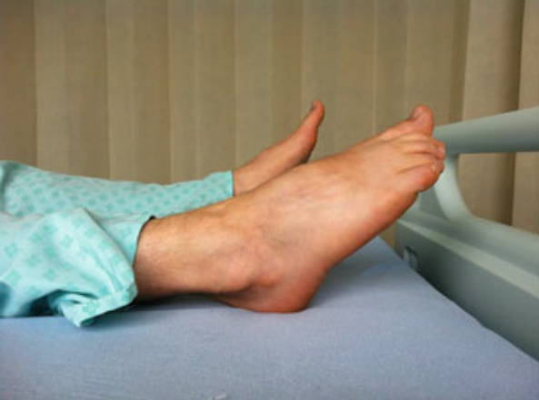
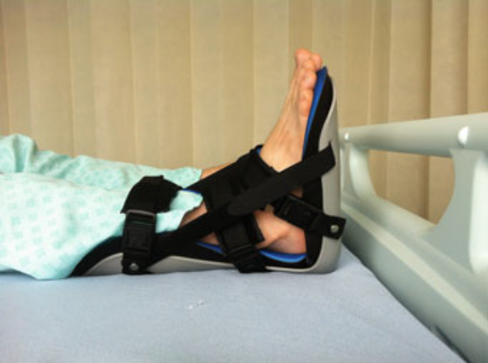
Positioning
patients should be allowed to adopt either a sitting-up or lying-flat head position in the first 24 hours, according to comfort
patients should be positioned to minimise the risk of aspiration and other respiratory complications, shoulder pain and subluxation, contractures and skin pressure ulceration

Slide 20
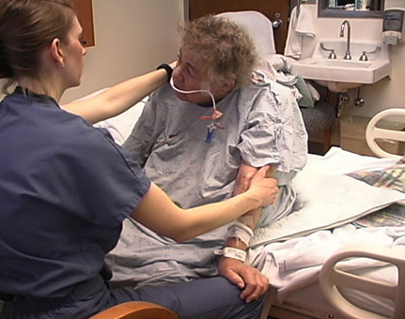
Early Mobilisation
early mobilisation includes sitting on the edge of the bed, transferring out of bed, standing and walking
patients with difficulty moving after stroke should be assessed as soon as possible within the first 24 hours to determine the most appropriate and safe methods of transfer and mobilisation

Slide 21
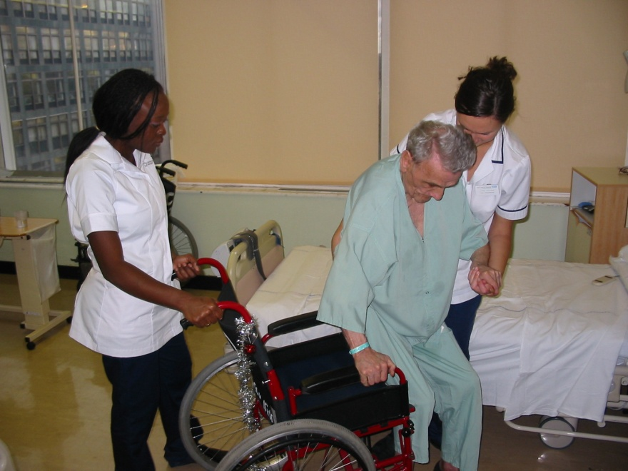
Early Mobilisation
patients should be offered frequent, short daily mobilisations with access to appropriate equipment, typically beginning between 24 and 48 hours of stroke onset
mobilisation within 24 hours of onset should only be for patients who require little or no assistance to mobilise

Slide 22
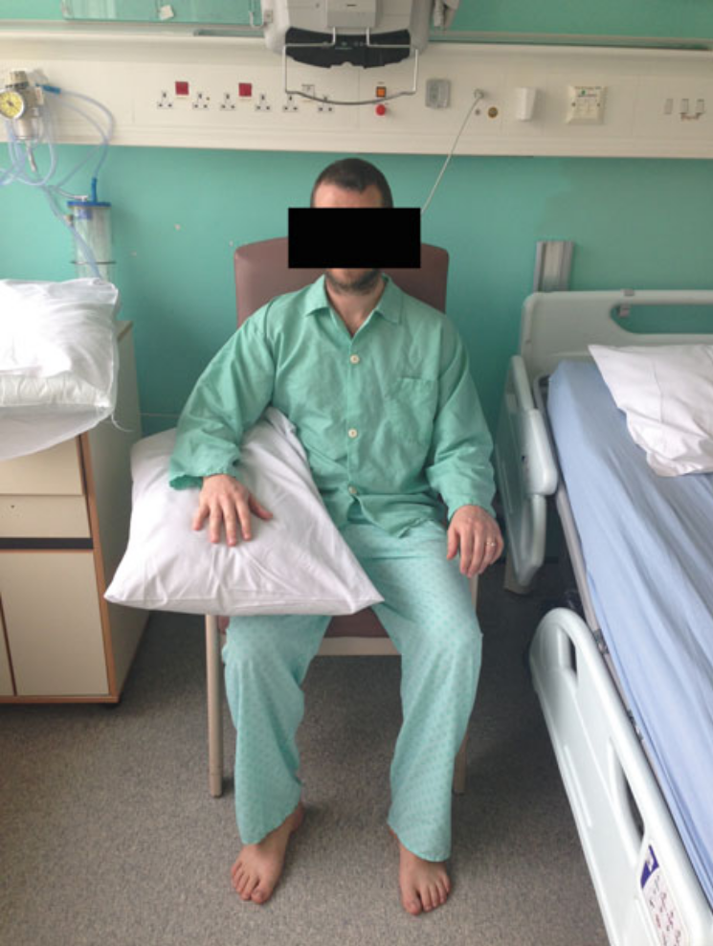
Upper Limb Management
upper limb management is guided by the degree of upper limb impairment
positioning and correct handling should be considered for patients with no or limited upper limb movement

Slide 23
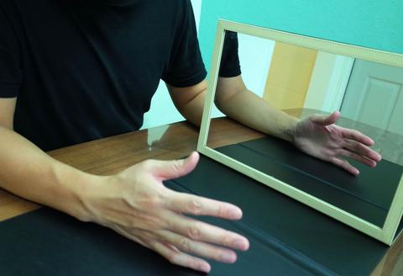
Upper Limb Management
patients with some upper limb movement should be offered repetitive task practice as the principal rehabilitation approach
patients who have at least 20 º active wrist extension and 10 º active finger extension should be considered for constraint-induced movement therapy
adjunctive therapies include functional electrical stimulation, mental practice and mirror therapy

Slide 24
MDT Rehabilitation
Speech and Language Therapy
swallowing assessment and appropriate strategies
communication assessment and management
Occupational Therapy
activities of daily living
cognitive assessment
Dietetics
- nutrition and hydration

Slide 25
References
[1] Bhalla A, Birns J. Management of post-stroke complications (2015). Switzerland: Springer International.
[2] Davenport RJ et al. (1996). Complications after acute stroke. Stroke. 27:415–20
[3] GBD 2016 Stroke Collaborators (2019). Global, regional, and national burden of stroke, 1990–2016: a 279 systematic analysis for the Global Burden of Disease Study 2016. Lancet Neurology, 18(5), 439– 458
[4] Intercollegiate Stroke Working Party (2023). National clinical guideline for stroke - 6th edition

Slide 26
References
[5] Langhorne P et al. (2000). Medical complications after stroke. A multicentre study. Stroke. 31:1223–9.
[6] McGlinchey M et al. (2015). Positioning and pressure care, in Bhalla, A and Birns J (eds) Management of Post-Stroke Complications. Springer, 189–225
[7] McGlinchey MP et al. (2021). The rehabilitation of physical function after severely disabling stroke: A survey of UK therapist practice. International Journal of Therapy and Rehabilitation, 28(7), 143
[8] Sacco RL et al. (2013). An updated definition of stroke for the 21st century: a statement for healthcare professionals from the American Heart Association/American Stroke Association. Stroke, 44(7), 2064–2089

